Slide 1
Citi Bike Data Analysis
By Innocent Ezama

Slide 2
Project Goal:
To better understand the behavior of Citi Bike’s customer base (both one-time users and subscribers) and how they use Citi Bikes
This will help us to:
Identify where more bikes should be installed
Create targeted marketing campaigns that will appeal to different customer segments

Slide 3
Key questions:
What are the most popular pick-up locations across the city for Citi Bike rental?
How does the average trip duration vary across different age groups?
Which age group rents the most bikes?
How does bike rental vary across the two user groups (one-time users vs long-term subscribers) on different days of the week?
Does the factor of user age impact the average bike trip duration?

Slide 4
Findings & Insights

Slide 5
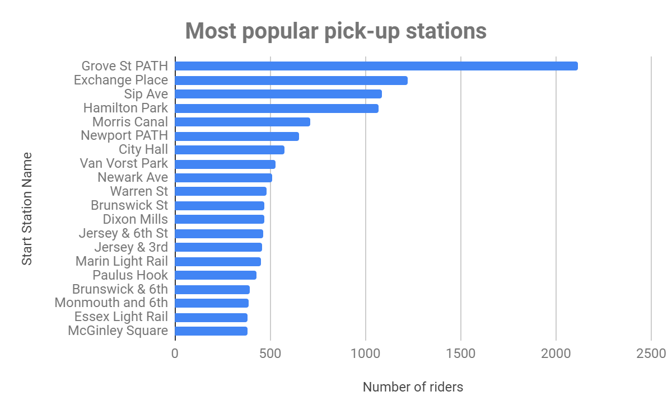

Slide 6
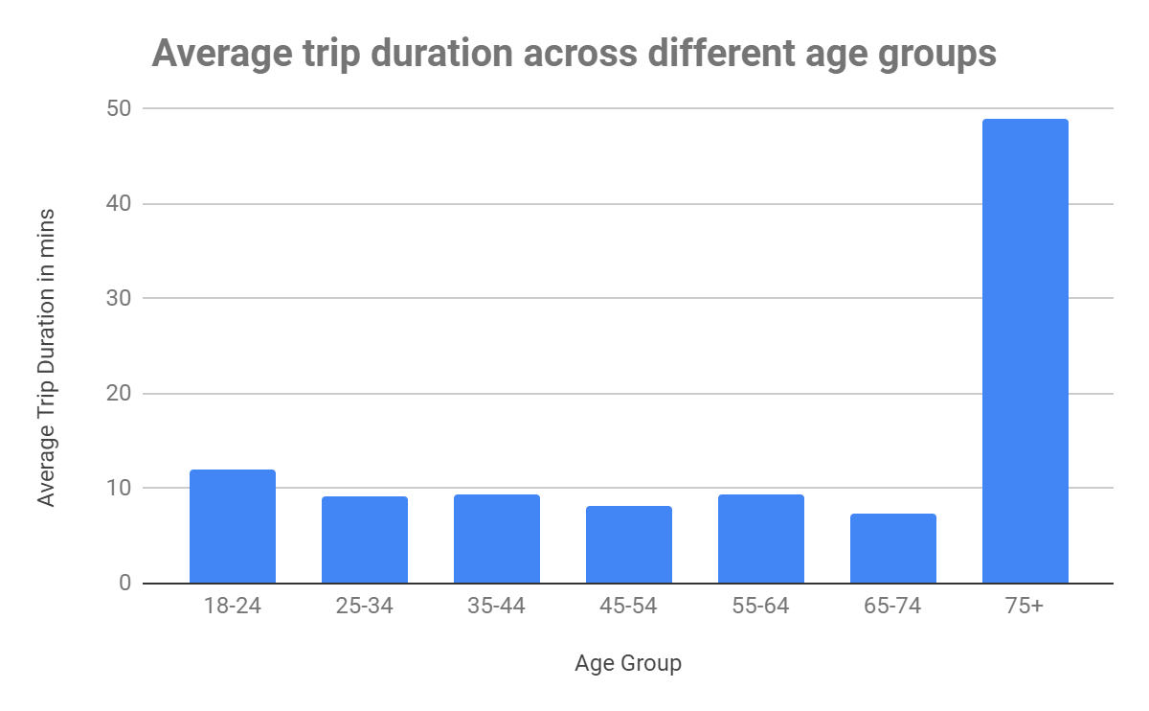

Slide 7
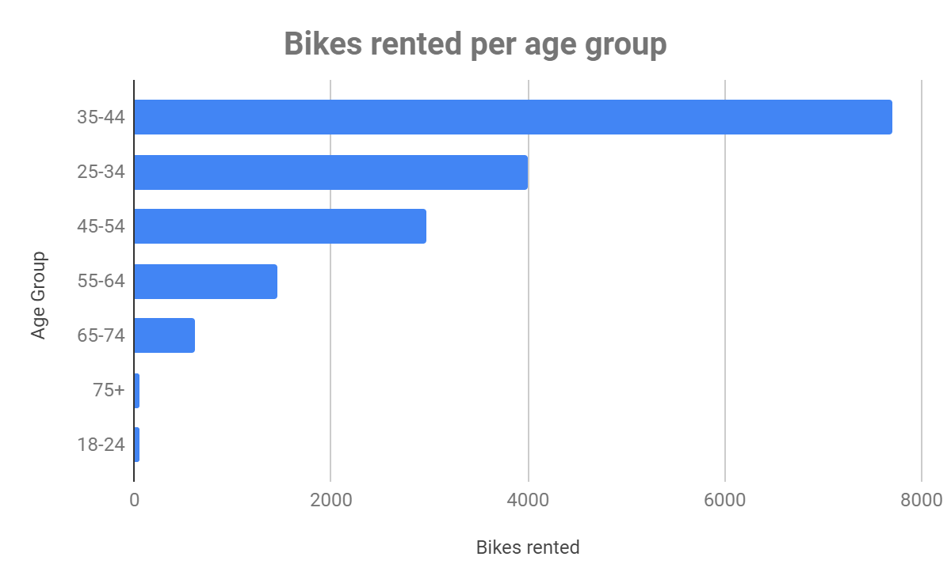

Slide 8
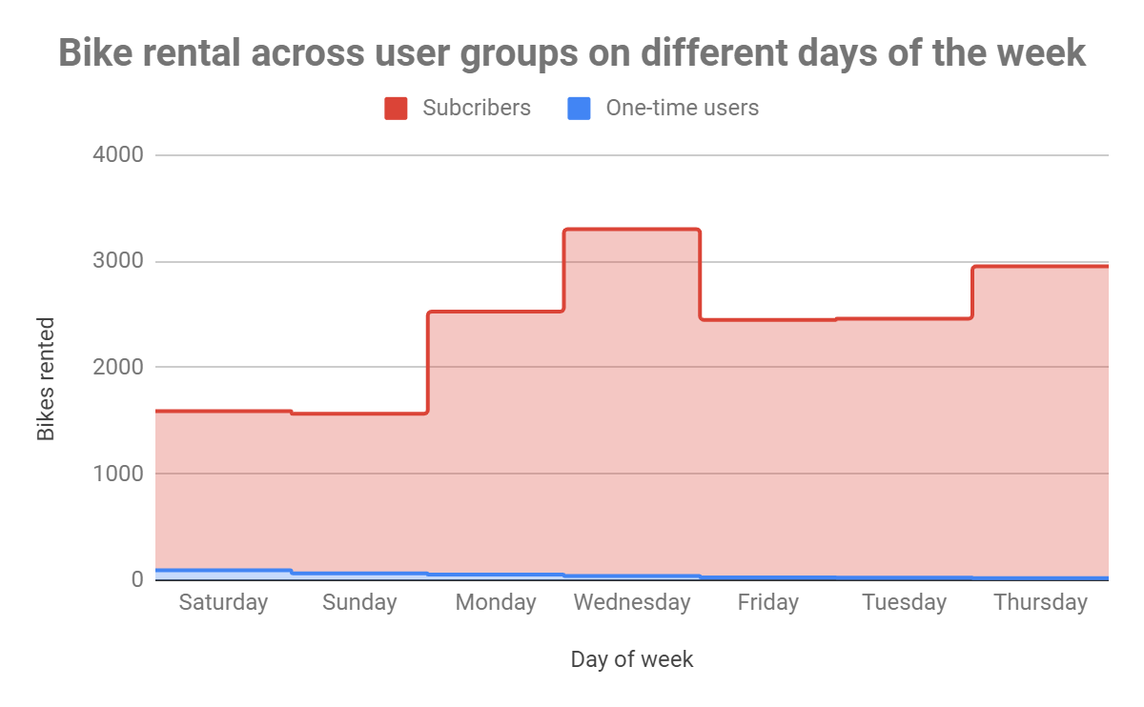

Slide 9
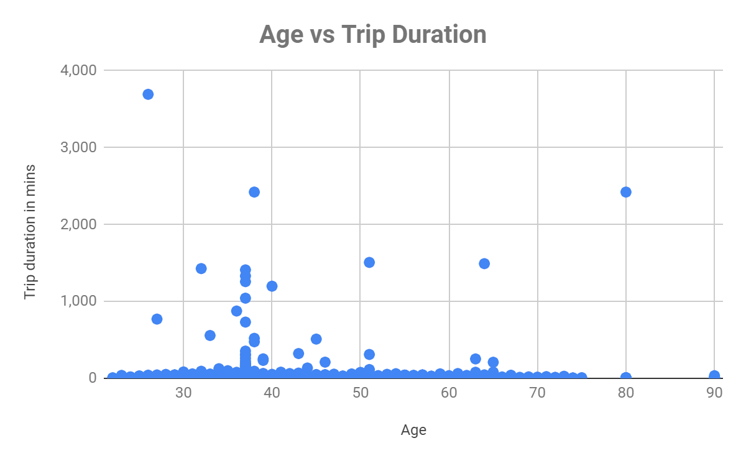
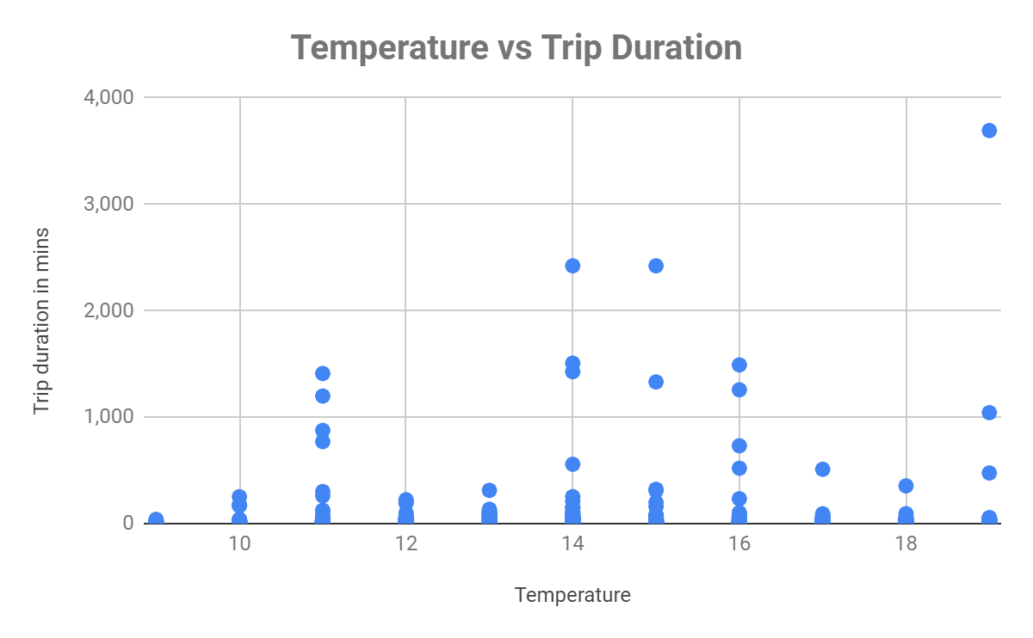
There doesn’t seem to be a notable correlation between the user’s age or temperature and how long they ride for.

Slide 10
Summary

Slide 11
Summary of findings:
Top 5 pick-up locations for bikes:
Grove St Path, Exchange Place, Sip Ave, Hamilton Park, & Morris Canal
Customer base:
Age: Predominantly 35-44 year olds, followed by 25-34 year olds.
User Type: A mix of one-time users and subscribers, with varying usage patterns on weekdays vs. weekends. More subscribers than one-time users.
Citi Bike customer behavior:
Trip Duration: Longest trips taken by 75+ year olds. Shortest trips by 65-74 year olds.
Weekly Usage Patterns: Higher one-time user activity on weekends, lower subscriber activity on weekends.

Slide 12
Actions & Recommendations

Slide 13
Recommended actions:
Product recommendations:
Install more bikes at Grove St Path, Exchange Place, Sip Ave, Hamilton Park, Morris Canal.
Senior-Friendly Enhancements: Ensure bikes and stations are senior-friendly.
Marketing recommendations:
The Citi Bike customer base is mostly long-term subscribers aged between 35-44, who are most active on weekdays. This tells us that they are probably people who live in New York and use Citi Bikes to commute. Marketing and advertising campaigns should therefore target this particular demographic.

Slide 14
Thank you!

